Slide 1
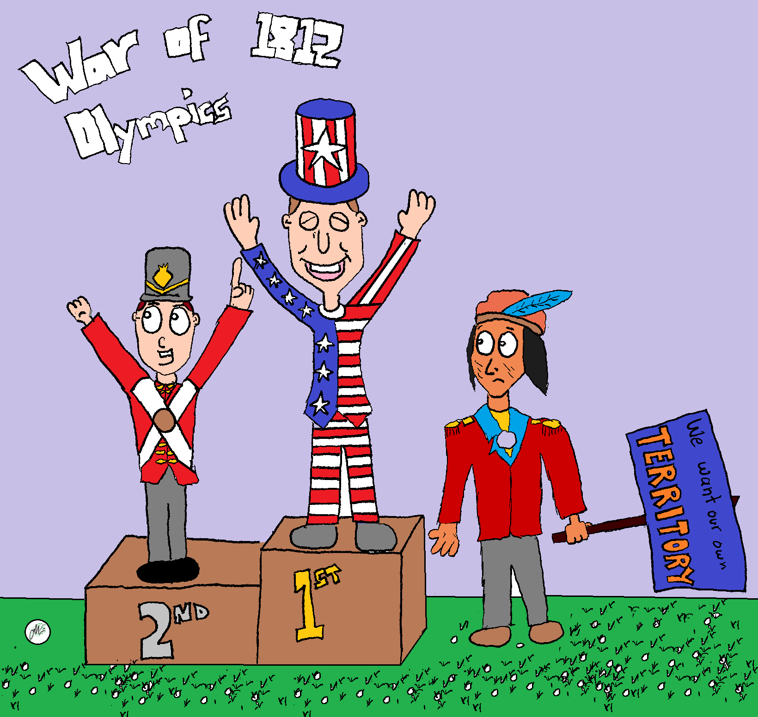
What’s Going On!?!?
Name:__________
In your own words, describe what is happening in the cartoon above.
Include information like
Who is in the Cartoon?
What does the cartoon have to do with The War of 1812?
What is the cartoon describing
If there is a joke, why is it funny based on what we know?
_____________________________________________________________________________________________________________________________________________________________________________________________________________________________________________________________________________________________
_____________________________________________________________________________________________________________________________________________________________________________________________________________________________________________________________________________________________

