Slide 1
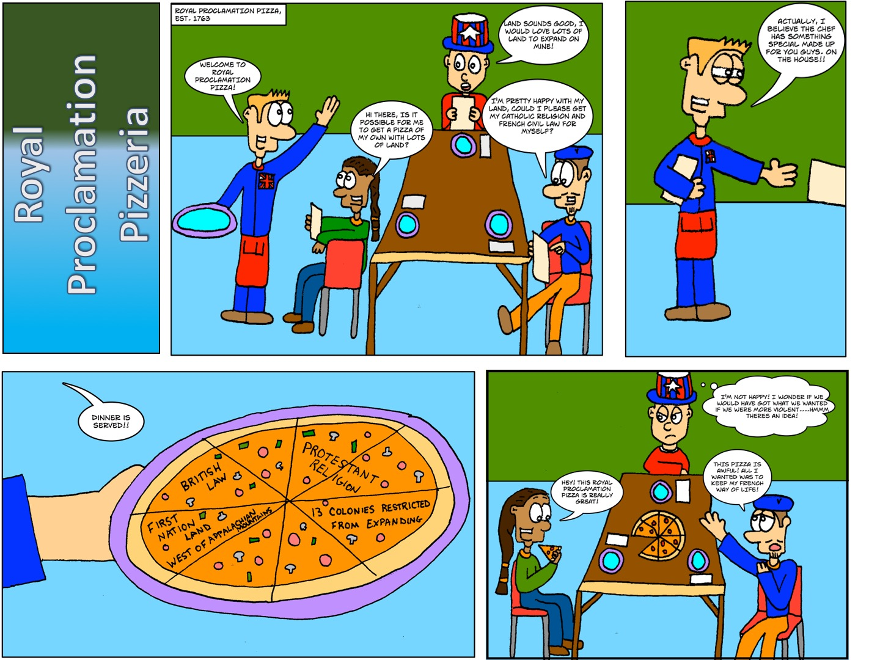
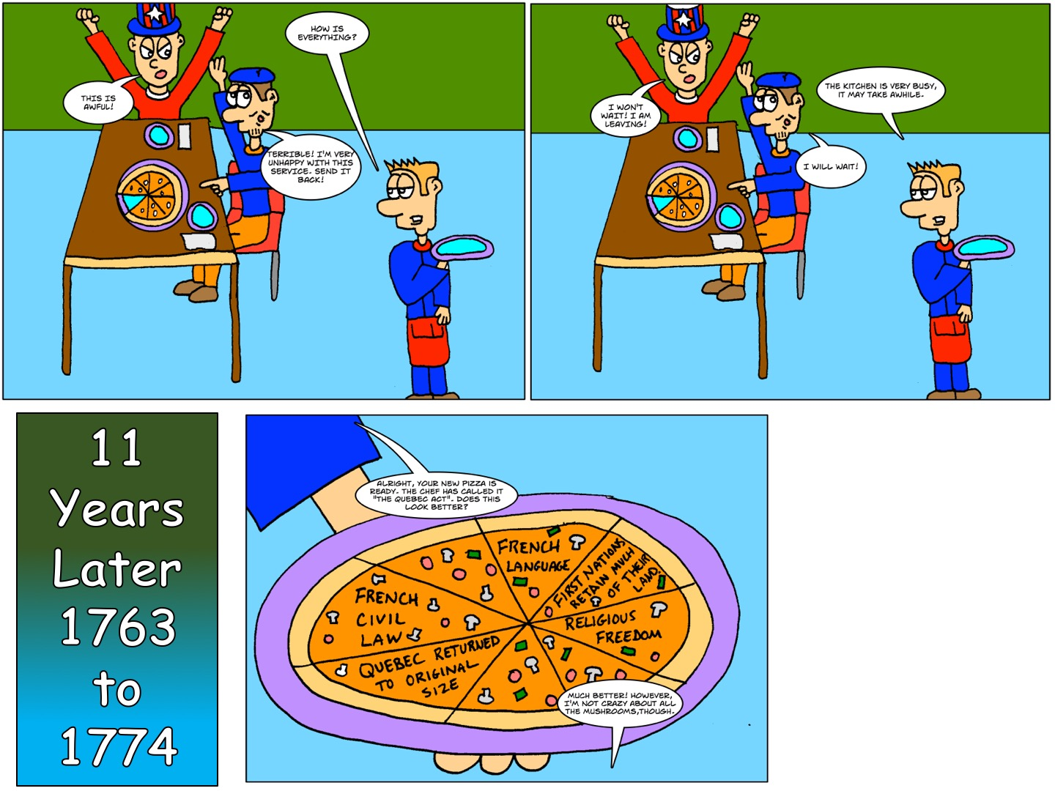
What’s Going On? The Royal Proclamation vs Quebec Act
Name:___________
What is happening in the cartoon above?
Who is in the cartoon?
What is being discussed?
Is there a joke or comparison being made?
What is happening in the Cartoon?
_________________________________________________________________________________________________________________________________________________________________________________________________________________________________________________________________________________________________________________________________________________________________________________

