Slide 1
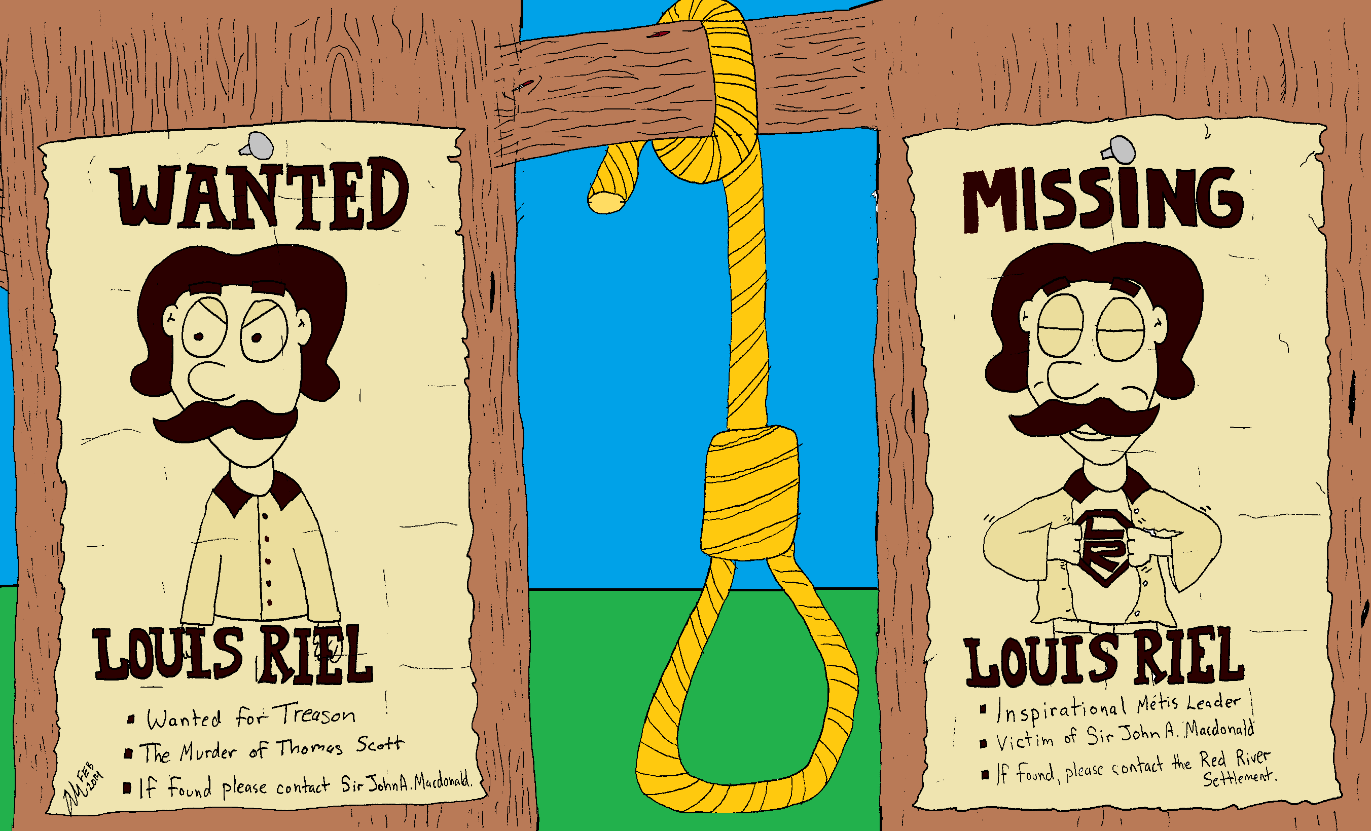
Whats Going On!?!?
Name:__________
In your own words, describe what is happening in the cartoon.
Include information like
Who is in the Cartoon?
What does the cartoon have to do with The Red River Resistance?
What is the cartoon describing
If there is a joke, why is it funny based on what we know about The Red River Resistance
________________________________________________________________________________________________________________________________________________________________________________________________________________________________________________________________________________________________________________________________________________________

Slide 2
Form an opinion on the following question and research the topic to back up your beliefs.
“WAS LOUIS RIEL A HERO OR A VILLIAN?”
If you believe that Louis Riel was a hero, look for evidence to support that argument, if you think he was a villain, what things did he do that would lead you to that opinion?
Write a short paragraph (5-7 Sentences) supporting your argument.
_____________________________________________________________________________________________________________________________________________________________________________________________________________________________________________________________________________________________________________________________________________________________________________________________________________________________________________________________________________________________________________________________________________

