Slide 1
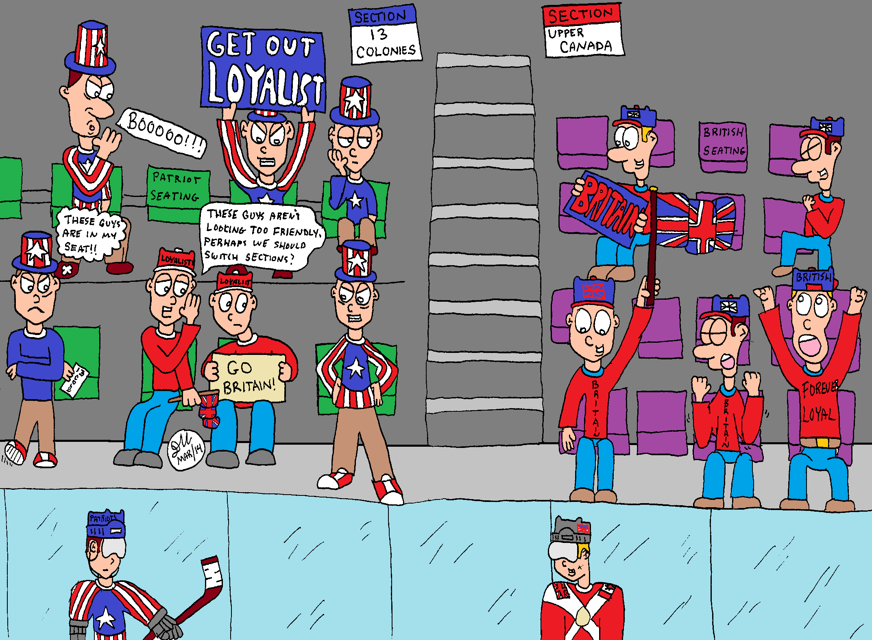
Whats Going On!?!?
Name:__________
In your own words, describe what is happening in the cartoon below.
Include information like
Who is in the Cartoon?
What does the cartoon have to do with New France?
What is the cartoon describing
If there is a joke, why is it funny based on what we know about New France.
___________________________________________________________________________________________________________________________________________________________________________________________________________________________________________________________________________________________________________________________________________________________________________________________________

