Slide 1
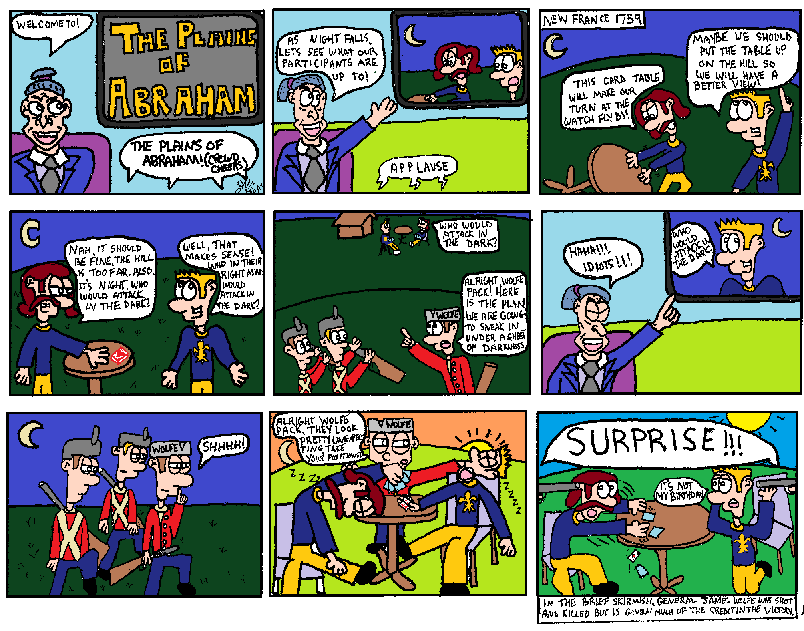
Whats Going On!?!?
Name:__________
In your own words, describe what is happening in the cartoon below.
Include information like
Who is in the Cartoon?
What does the cartoon have to do with New France?
What is the cartoon describing
If there is a joke, why is it funny based on what we know about New France.
___________________________________________________________________________________________________________________________________________________________________________________________________________________________________________________________________________________________________________________________________________________________________________________________________

Slide 2
The Outcome of “The Plains of Abraham”
What happened to the French’s land in North America following the “Plains of Abraham”?
How was British North America affected by The Rebellion in the 13 colonies?
Who were the Loyalists?
What was the Loyalist Migration?
_______________________________________________________________________________________________________________________________________________________________________________________________________________________
_______________________________________________________________________________________________________________________________________________________________________________________________________________________
_______________________________________________________________________________________________________________________________________________________________________________________________________________________
__________________________________________________________________________________________________________________________________________________________________________________________________________________________________________________________________

