Slide 1
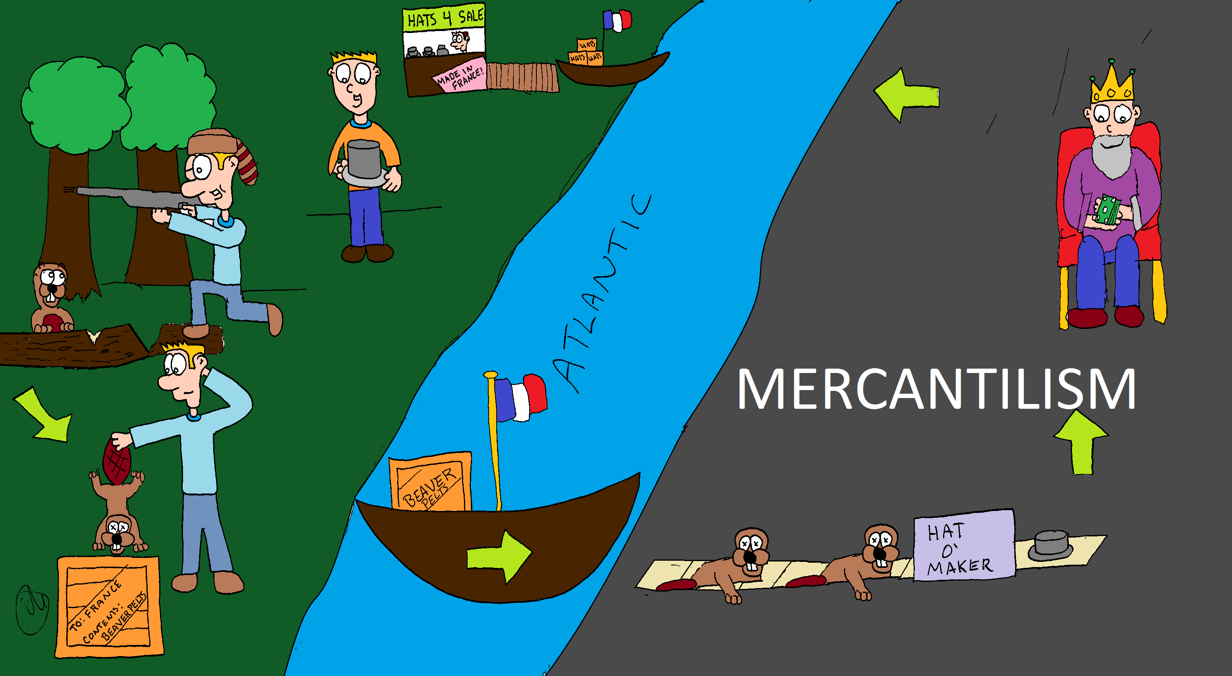
Whats Going On!?!?
Name:__________
In your own words, describe what is happening in the cartoon above.
____________________________________________________________________________________________________________________________________________________________________________________________________________________________________________
Where do you think the cycle above begins? Why do you think this?
____________________________________________________________________________________________________________________________________________________________________________________________

