Slide 1
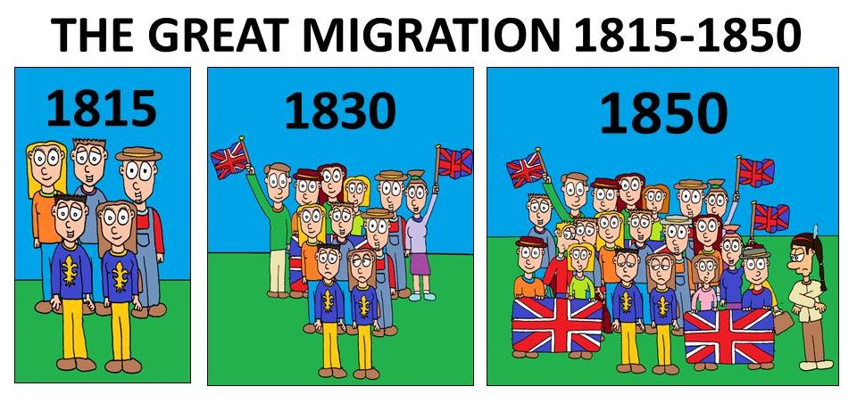
Whats Going On!?!?
Name:__________
In your own words, describe what is happening in the cartoon.
Include information like
Who is in the Cartoon?
What does the cartoon have to do with The Great Migration?
What is the cartoon describing
If there is a joke, why is it funny based on what we know about The Great Migration .
____________________________________________________________________________________________________________________________________________________________________________
How is this cartoon showing that The Great Migration was an attempt to confirm British identity?
____________________________________________________________________________________________________________________________________________________________________________

