Slide 1
What’s Going On…In Acadia
Name:___________
Cartoon Questions
What is happening in this cartoon?
Who is in this Cartoon?
Why are the Acadians upset?
Who were the Acadians?
Where in Canada did the Acadians live? What is that area called today? (Name of Province)
“Going Further” Questions

Slide 2
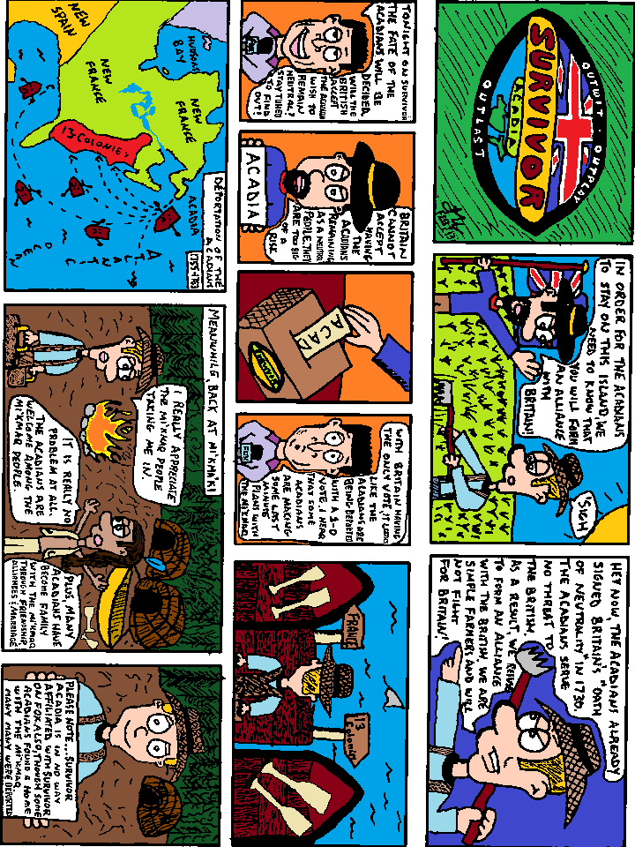
What’s Going On…In Acadia

