Slide 1
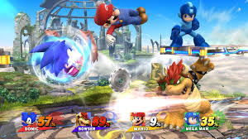
THE WEEKLY GAME REVIEW
Reviewed By: Mr. Morris
GAME REVIEWED: Super Smash Bros Wii U PLATFORM: Nintendo Wii U
REPORT CARD
A-
OVERALL
A+
GAMEPLAY
PICTURE
OF
GAMEPLAY
A
ENTERTAINMENT
B+
GRAPHICS
A+
MULTIPLAYER
REPORT CARD COMMENTS
GAMEPLAY:_______________________________________________________________________________________________________________________________________________________________________
ENTERTAINMENT:__________________________________________________________________________________________________________________________________________________________________
GRAPHICS:________________________________________________________________________________________________________________________________________________________________________
MULTIPLAYER:_____________________________________________________________________________________________________________________________________________________________________

