Slide 1
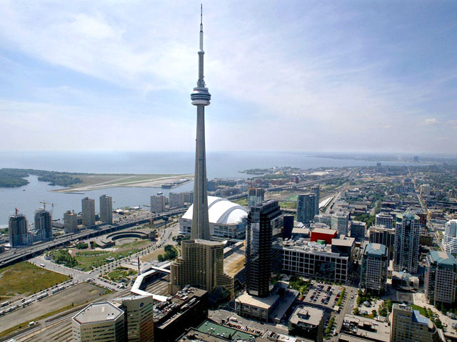
Structures and Forces

Slide 2
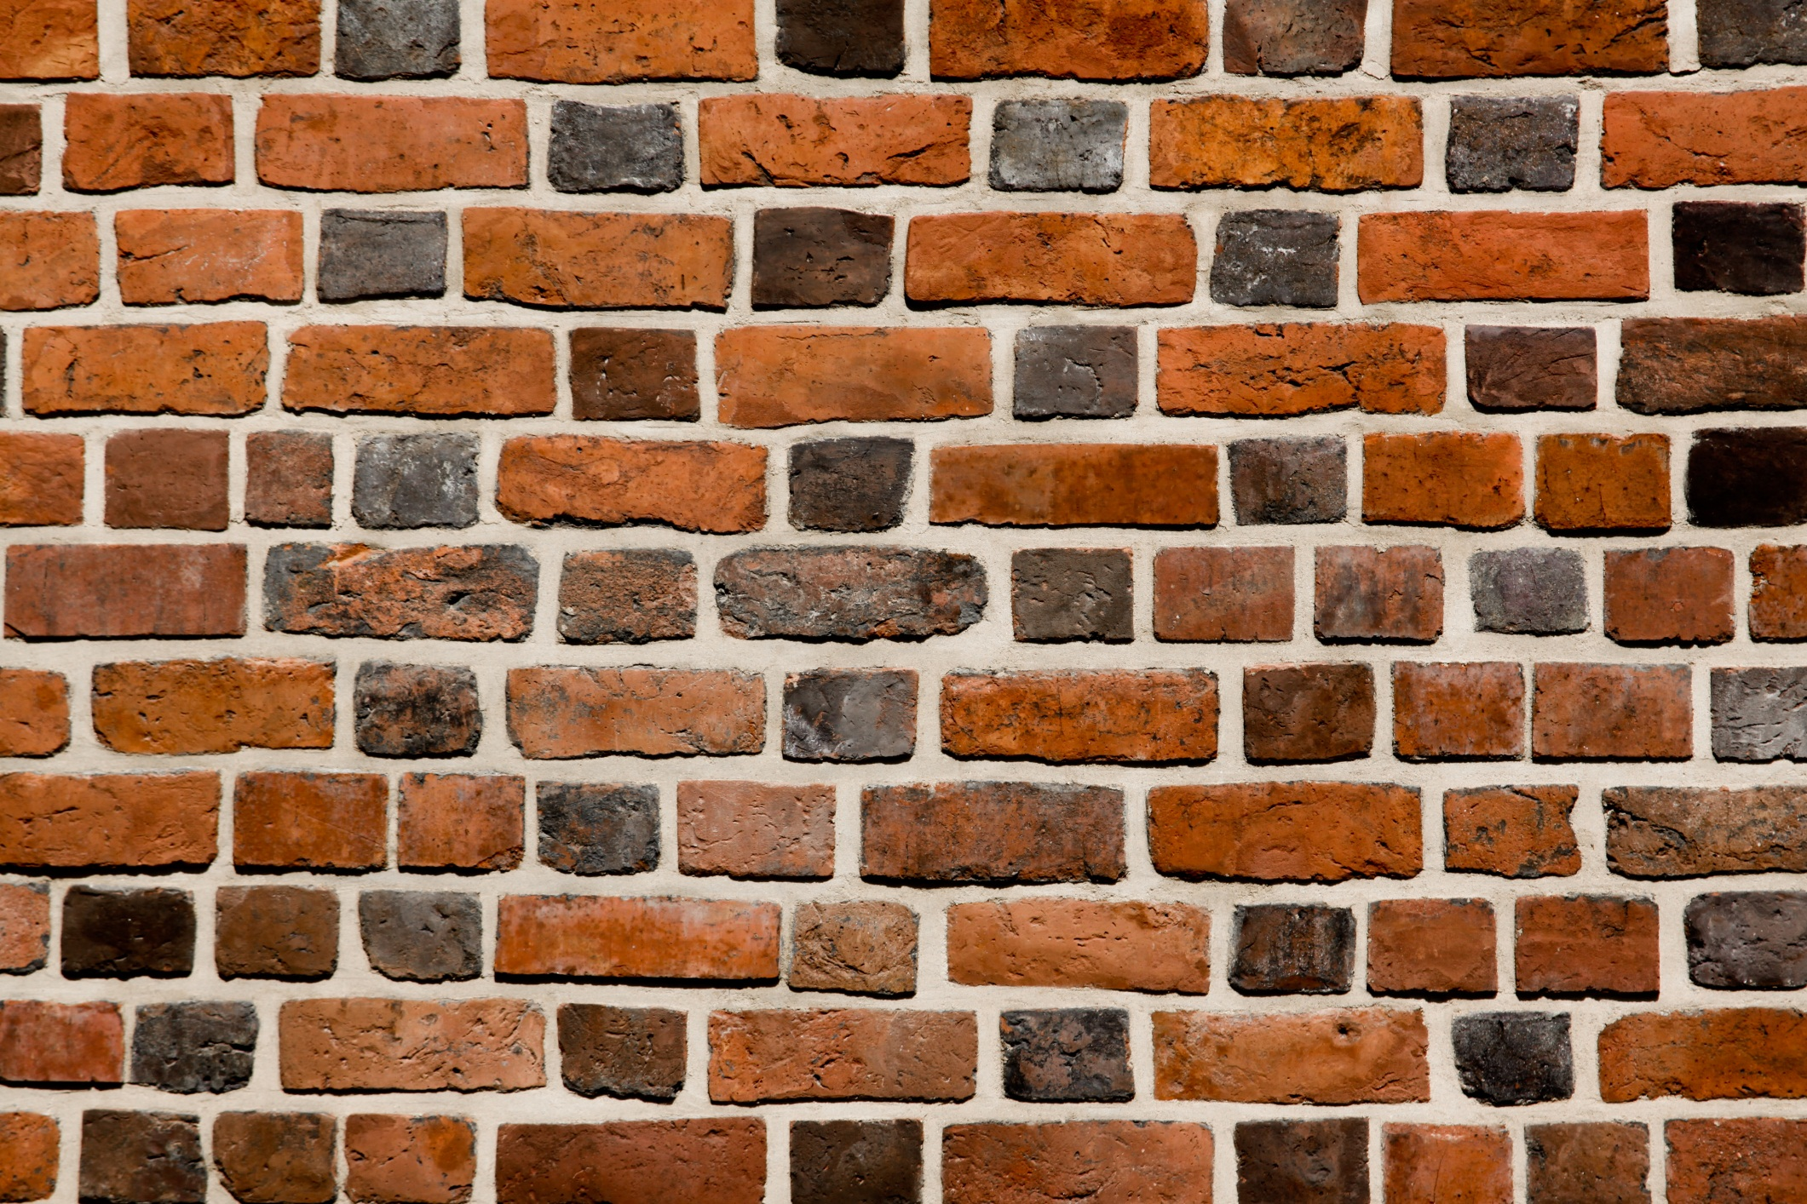
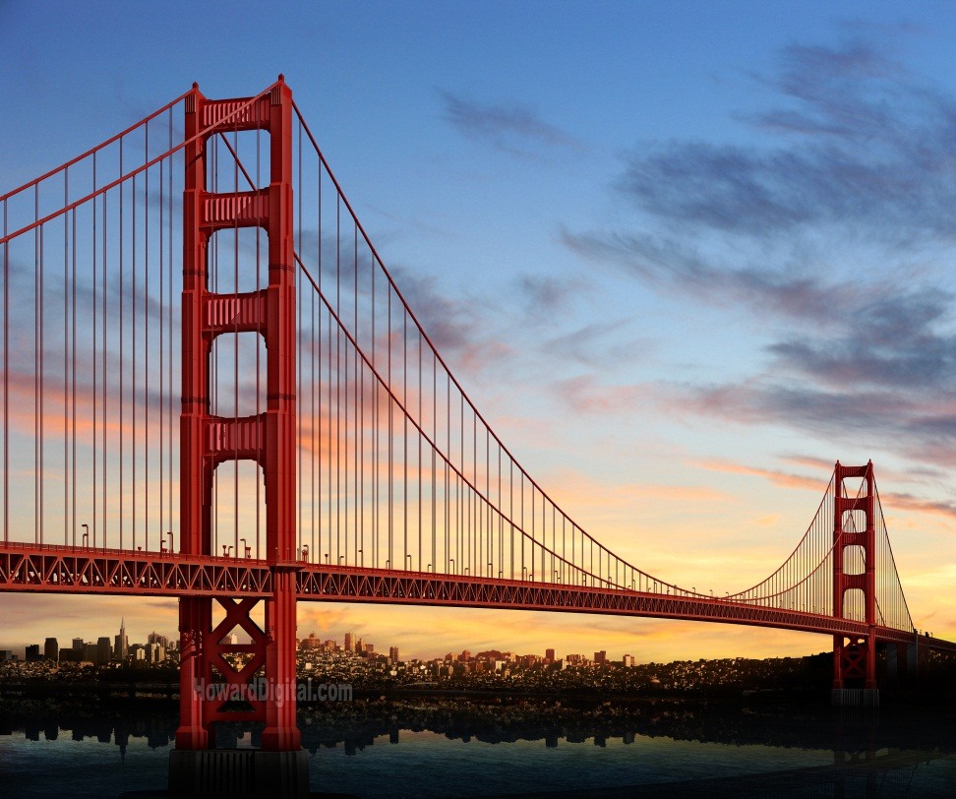
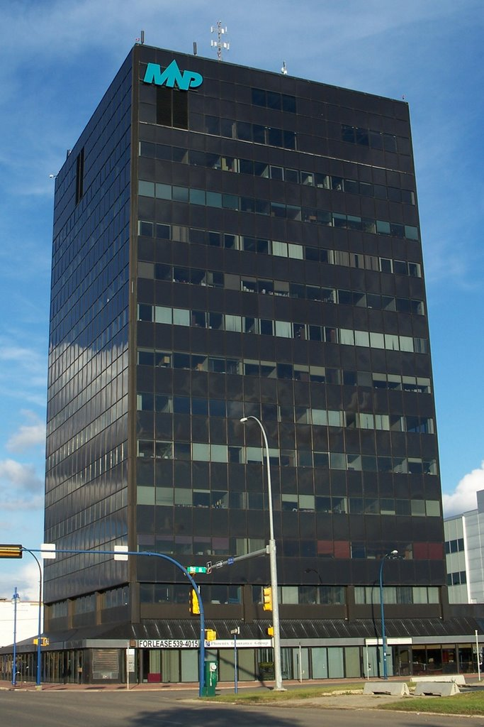
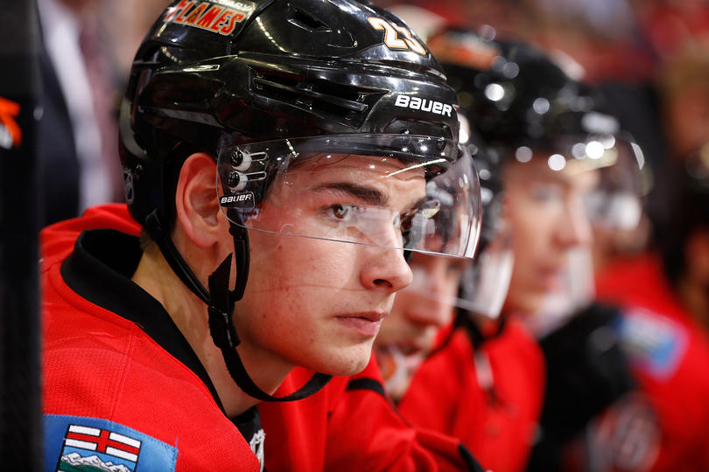
What is a Structure?
Structures are things with a definite shape that serves a specific purpose or function.
Structures can either resist force, or perform a function.

Slide 3
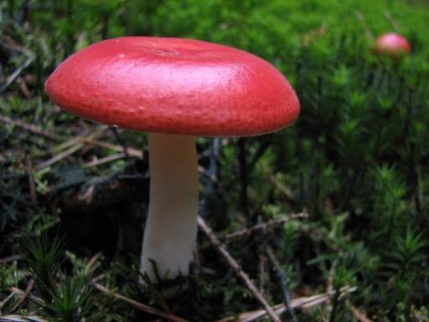
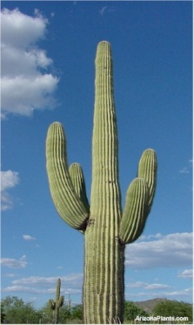
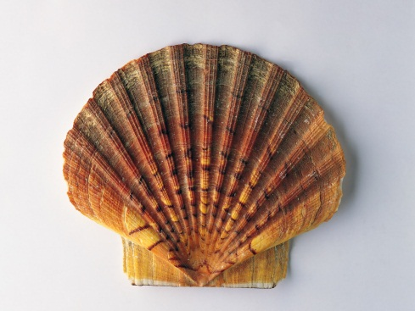
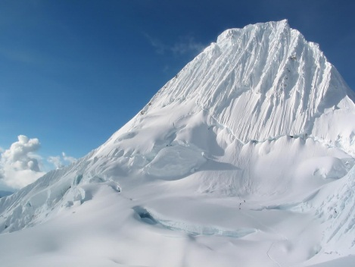
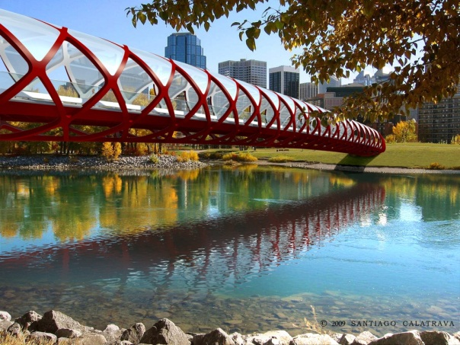
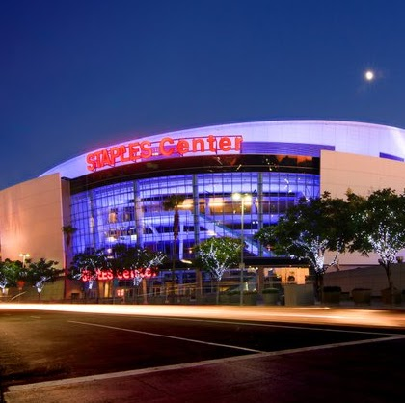
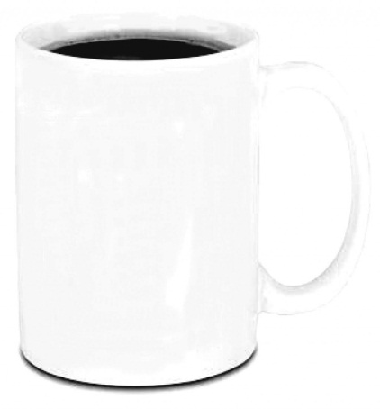
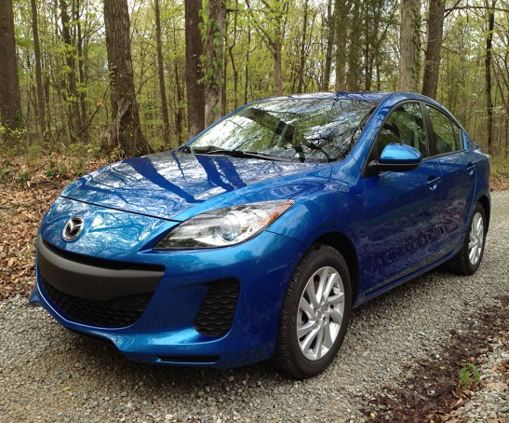
Natural Structures vs Manufactured Structures
Natural Structure – A structure that is grown as it is.
Manufactured Structure – A structure that is created with multiple items by Man or Animal.

Slide 4
3 Types of Structures
Every Structure will fall under one of these 3 categories…Don’t challenge me on it, cause I don’t know if I can answer your question…kidding. Sort of, I mean that would be pretty embarrassing if I didn’t. right?
Mass Structures
Frame Structures
Shell Structures

Slide 5
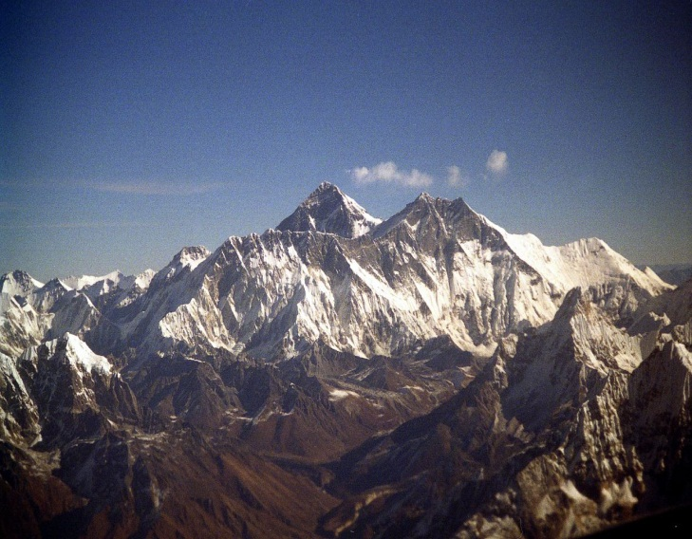
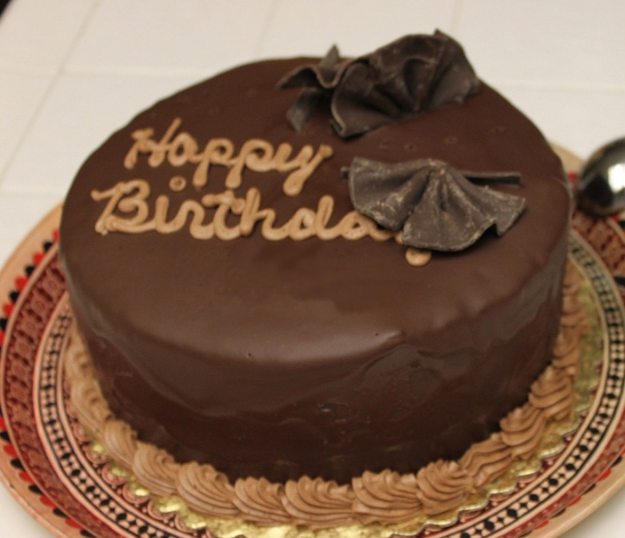
Mass Structures
Mass Structures are held firmly by their own weight
Examples of these type of structures is Mountains, Walls, Cakes, etc.

Slide 6
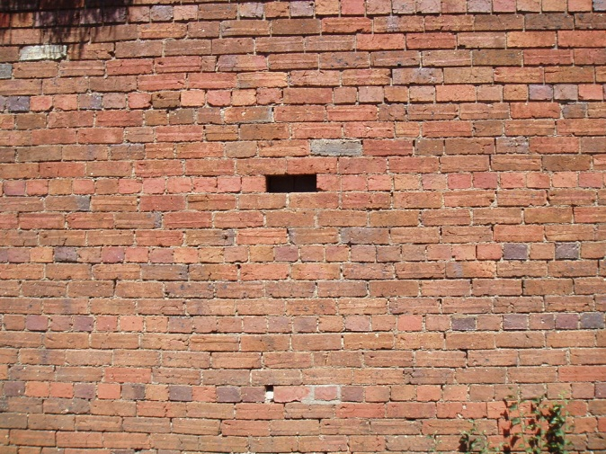
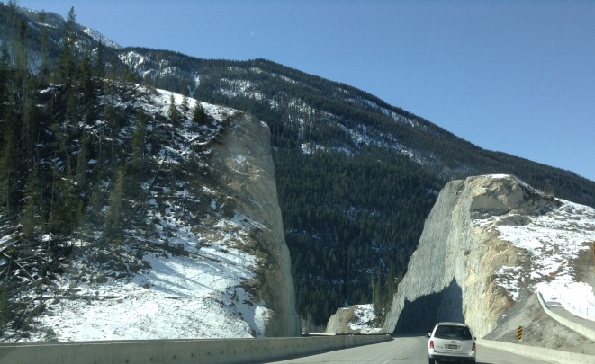
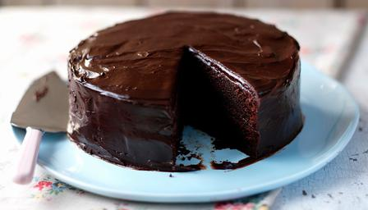
Mass Structures
With a Mass Structure, you can always take out a piece of it until there is nothing left and it will still remain intact.

Slide 7
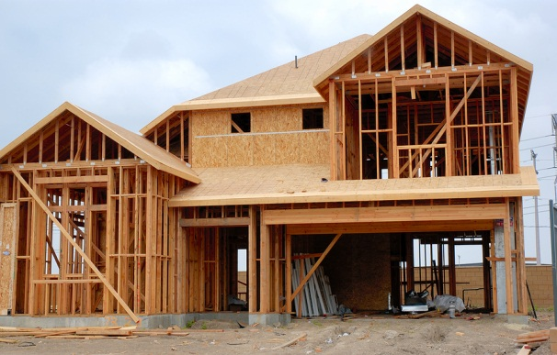
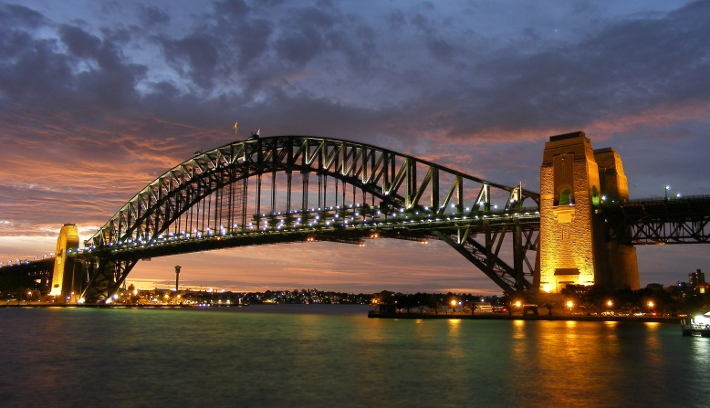
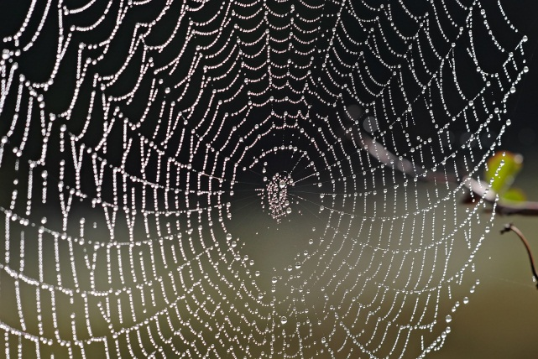
Frame Structures
In a Frame Structure, the frames act as skeletons.
Frame Structures are primarily hollow or empty. This makes Frame Structures good for living in
Frame Structures require a strong frame to hold the majority of the load.
Houses, Buildings, Bridges and Spider webs are examples of Frame Structures.

Slide 8
Shell Structures
Shell Structures are strong and hollow and rely on their shape for their strength.
Two Useful features of Shell Structures
They are completely empty/hollow
Require little building materials
A Helmet is a good example of a Shell Structure.

Slide 9
Scavenger Hunt!
You and a partner are going to go exploring around the school for examples of each of the 3 types of structures. Mass, Frame, and Shell.
Points will be given for unique structures that no one else has. (If only one group finds a helmet for shell structure, they receive a point. If more than one group finds a helmet as their shell structure, no one gets points)
There MAY be a reward for the winning pair!

