Slide 1
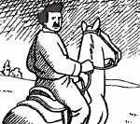
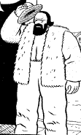
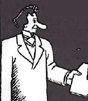
The Metis Rise Up
Louis Riel
Gabriel Dumont
Thomas Scott
Sir John A. Macdonald

Slide 2
What you need to know.
Phase 1
Canadian Surveyors entered the Red River Settlement
The Red River Settlement was a Metis settlement
The area was part of Rupert’s Land
The area was sold to the Canadian Government for £300,000 (roughly $1.5 Million)
The Metis were upset about this.
Louis Riel was in charge of the Metis government since he was educated and spoke English

Slide 3
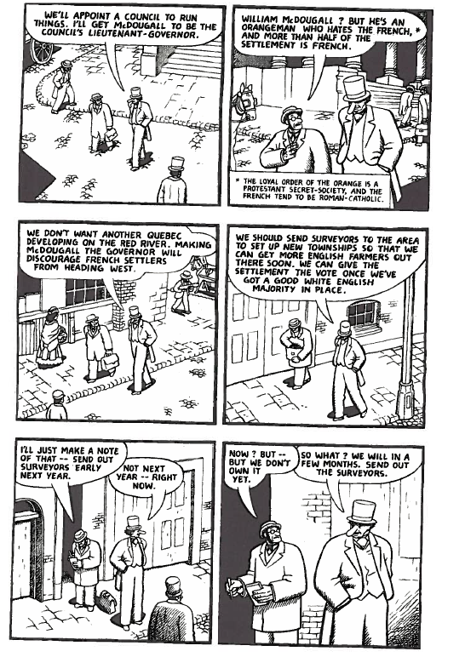
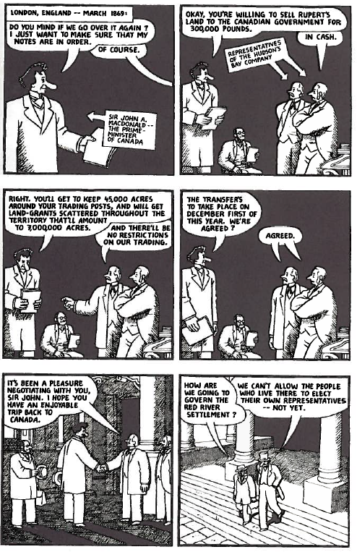
The Red River Resistance

Slide 4
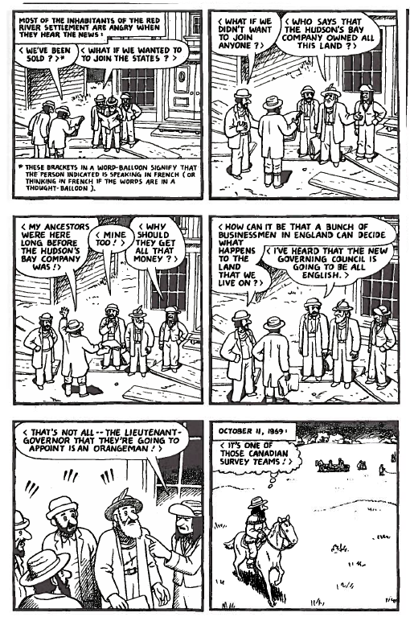
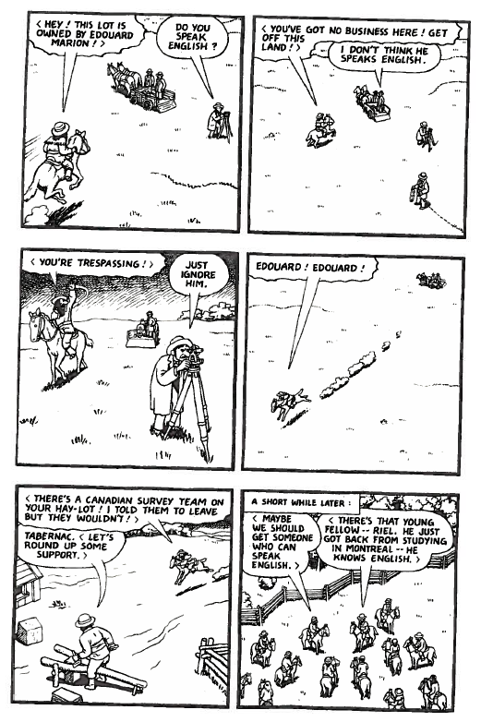

Slide 5
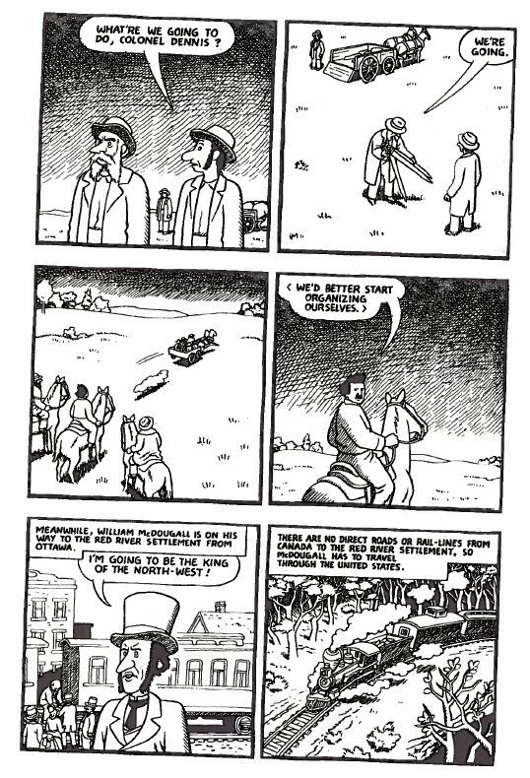

Slide 6
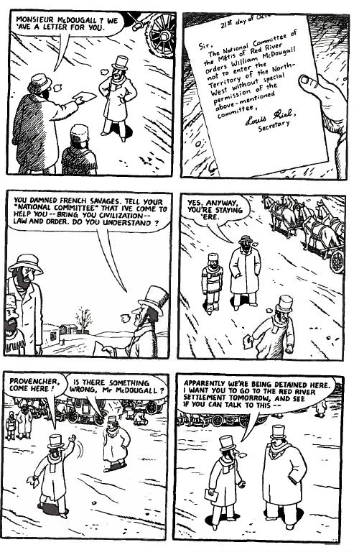

Slide 7
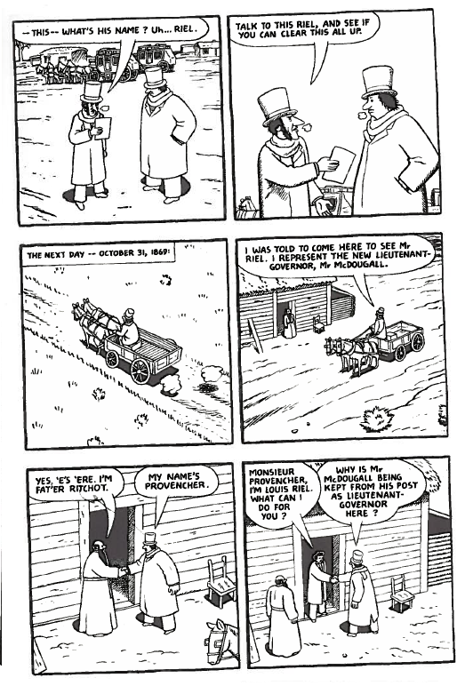
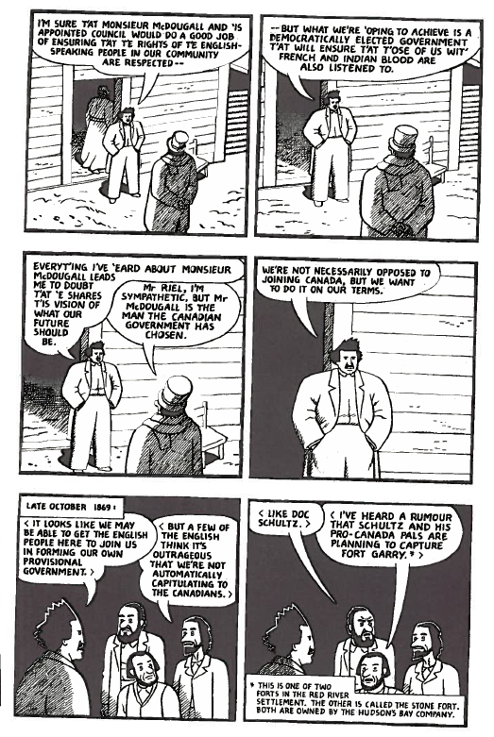

Slide 8
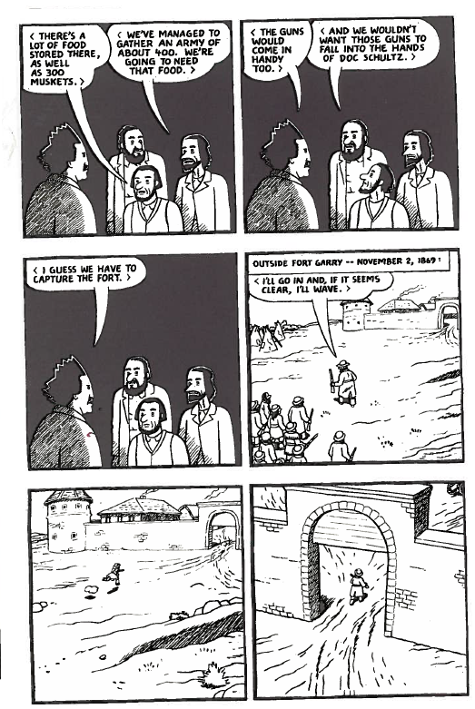
The Metis were upset that they were not consulted when their land was sold to Canada.
The Metis decided to resist by capturing Fort Garry and take it’s people prisoner.
Among those taken prisoner was Thomas Scott.

Slide 9
Phase 2 The Red River Resistance
After taking Thomas Scott prisoner, Scott became rather belligerent towards the Metis.
Louis Riel was faced with a dilemma.
The Metis provisional government found Thomas Scott guilty of Treason and had him executed.
Louis Riel didn’t want to lose the support of the Metis, so he went along with the execution.
This would eventually lead to the execution of Louis Riel. (Spoiler Alert)

Slide 10
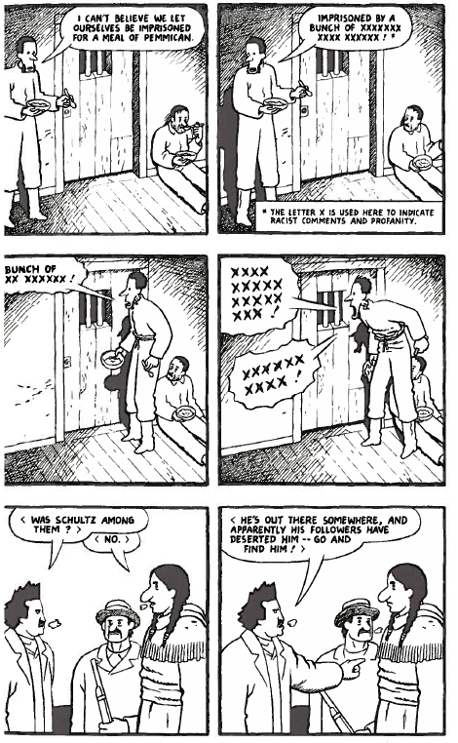
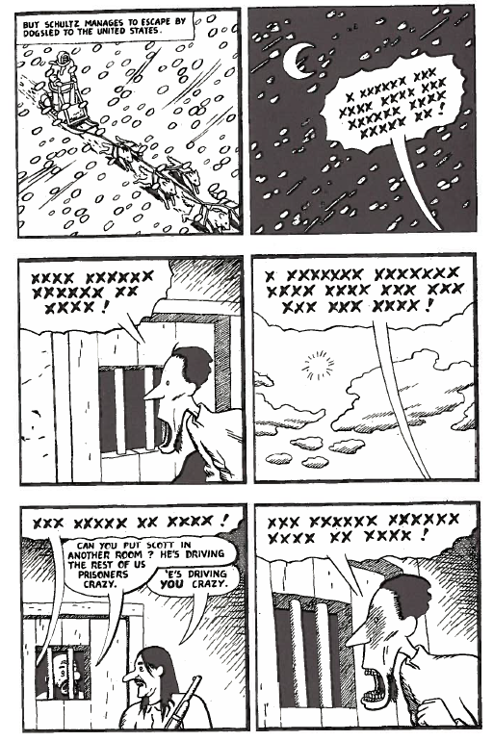

Slide 11
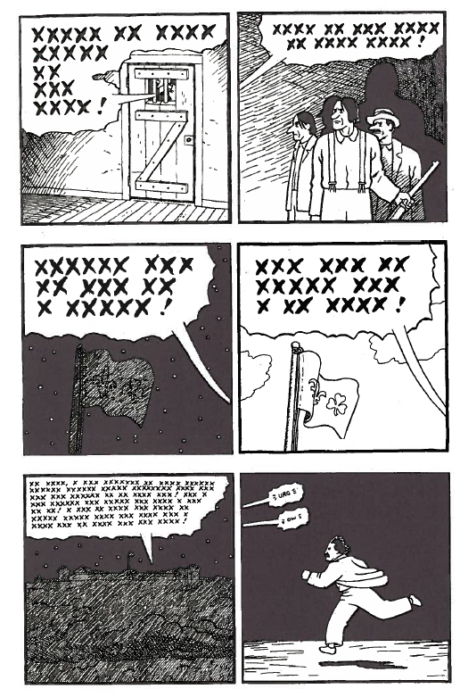

Slide 12
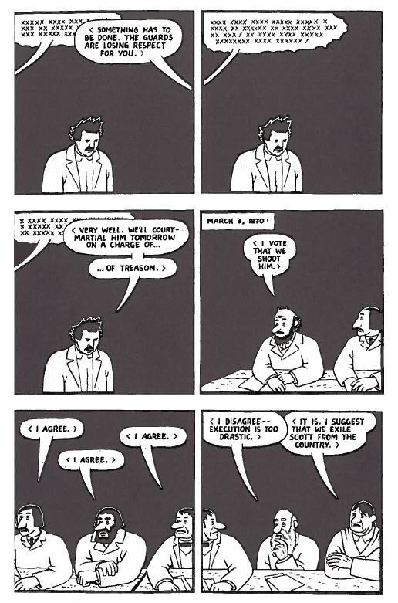

Slide 13
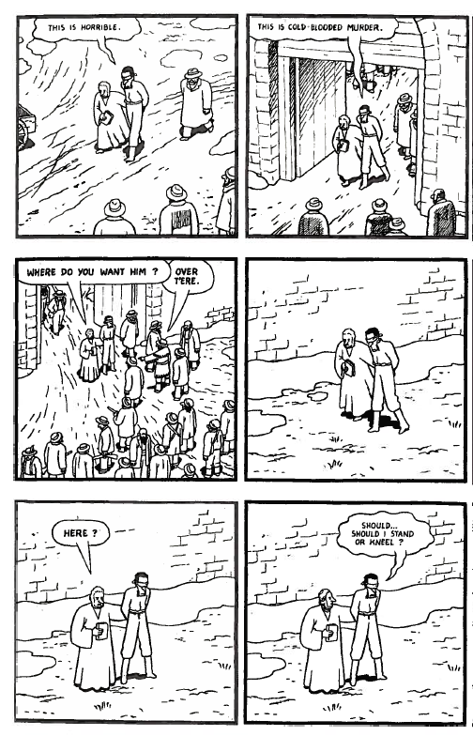

Slide 14
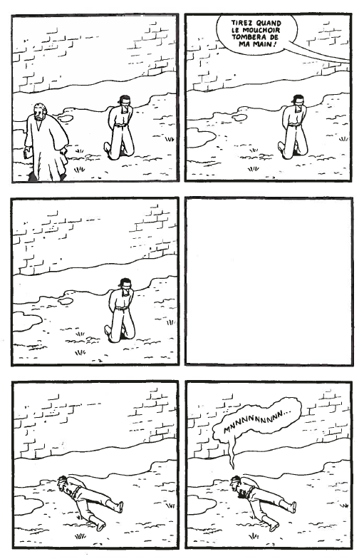

Slide 15
Thomas Scott was executed on the charges of Treason
The Metis did this to set an example for the Government
Since Louis Riel chose not to spare Thomas Scotts Life, he was wanted for Murder and High Treason. So Riel fled to the States

Slide 16
The Second Metis Uprising
Started when Land Speculators were marketing the land for the Railway west
In 1884, Gabriel Dumont went to seek the help of Louis Riel who had fled to Montana
Gabriel Dumont

Slide 17
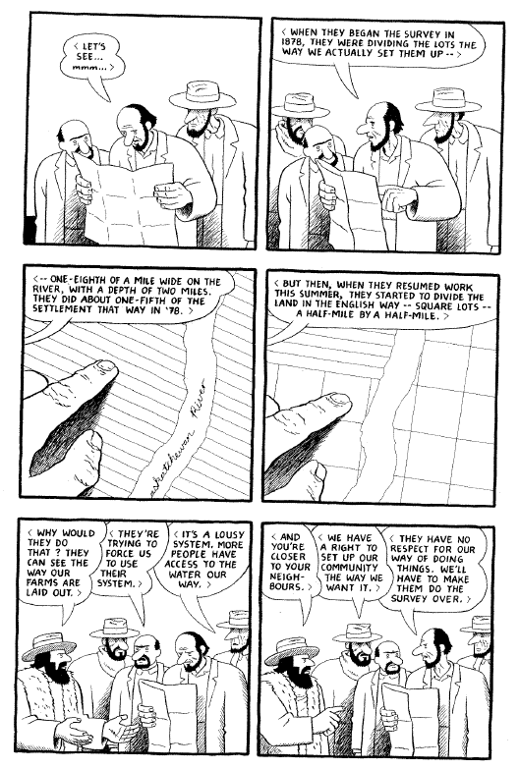

Slide 18
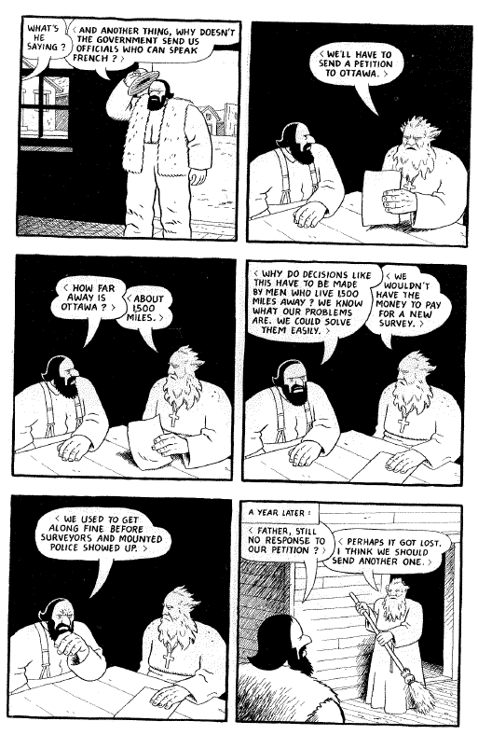

Slide 19
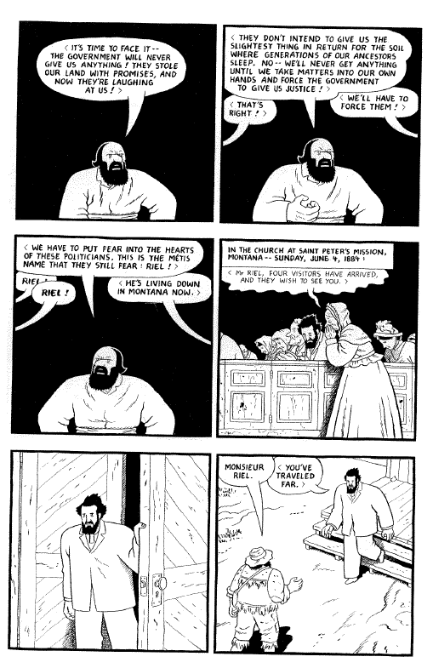

Slide 20
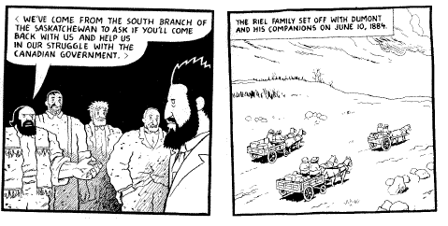
Dumont successfully recruited Louis Riel to help fight the Canadian Government
Riel would help Dumont set up a new provisional government.
This triggered the Canadian Government to send in troops to Batoche to fight the Metis.
“The Battle of Batoche”

Slide 21
The Fall Out from the Metis Uprising
Louis Riel gave himself up to the Canadian Government in hopes of it ending the battle with Canada
Though the main reason Louis Riel was executed for the Murder of Thomas Scott, he was officially tried for High Treason
The Manitoba School Act was created which removed French as the official second language in Manitoba.
The Manitoba School Act also halted government funding for Catholic Schools.

