Slide 1
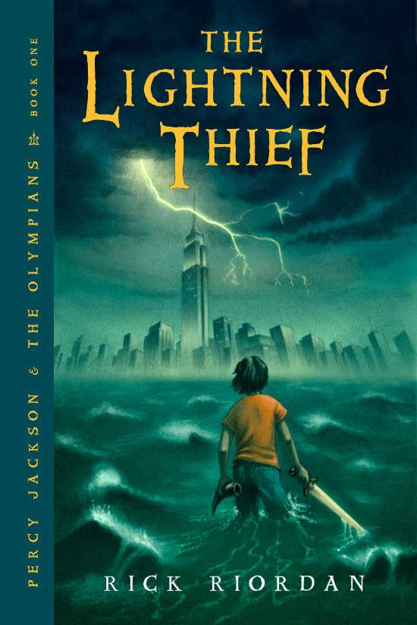
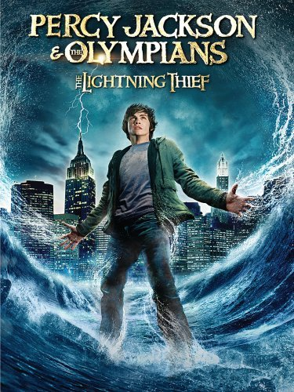
Pre-Reading Activities
Book Cover vs. Movie Poster
Book Cover
Movie Poster

Slide 2
Pre-Reading Activities
Book Cover vs. Movie Poster
How can a Book Cover or Movie Poster affect your feelings towards a book or a movie?
What are some big differences between the Book Cover and the Movie Poster that could affect your overall impression towards the storyline?
Based on the Book Cover and Movie Poster, which format are you more drawn towards? The Movie or the Book? Why?

