Slide 1
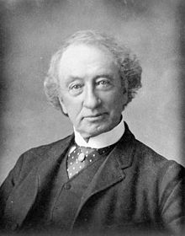
Sir John A. MacDonald
Background: ___________________
Birthplace:_______________
Occupation:______________
Known for/accomplishment:
________________________________________________________________________________________________________________________________________________________________________________________________________________________________________
What did he Support?
________________________________________________________________________________________________________________________________________________________________________________________________________________________________________

Slide 2
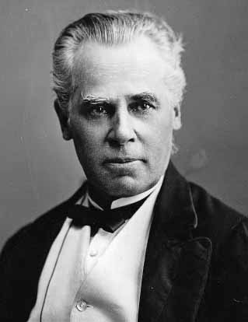
George-Etienne Cartier
Background: ___________________
Birthplace:_______________
Occupation:______________
Known for/accomplishment:
________________________________________________________________________________________________________________________________________________________________________________________________________________________________________
What did he Support?
________________________________________________________________________________________________________________________________________________________________________________________________________________________________________

Slide 3
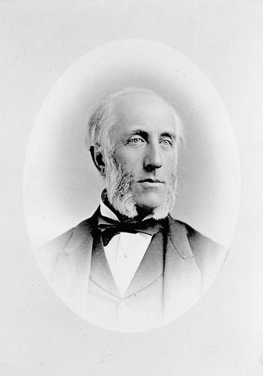
George Brown
Background: ___________________
Birthplace:_______________
Occupation:______________
Known for/accomplishment:
________________________________________________________________________________________________________________________________________________________________________________________________________________________________________
What did he Support?
________________________________________________________________________________________________________________________________________________________________________________________________________________________________________

