Slide 1
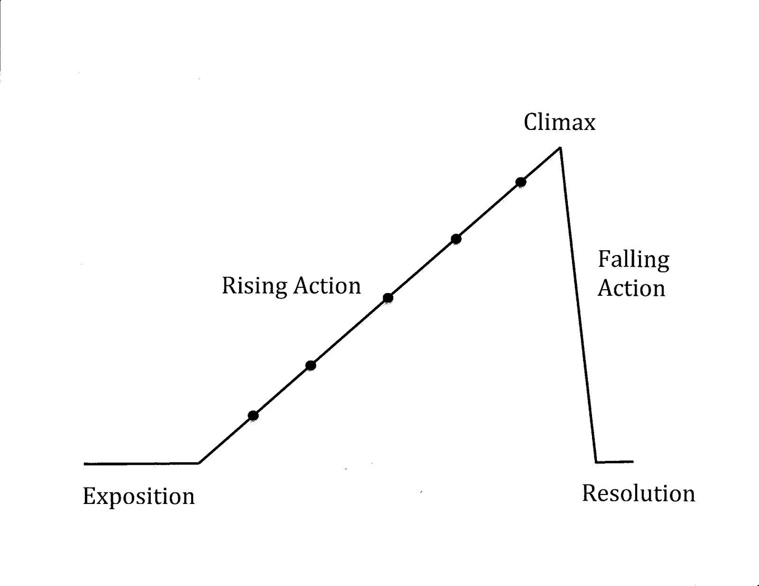
Creative Writing: Plot
Name:__________
Use this guide to help organize and plan the plot/storyline of your creative writing piece.
E
D
C
B
A
Exposition/Introduction: ________________________________________________________________________________________________________________________________________________________________________________________________________________________

Slide 2
Rising Action:
______________________________________________________________________________________________________
______________________________________________________________________________________________________
______________________________________________________________________________________________________
______________________________________________________________________________________________________
______________________________________________________________________________________________________
Climax:
__________________________________________________________________________________________________________________________________________________________________
Falling Action:
__________________________________________________________________________________________________________________________________________________________________
______________________________________________________
Resolution/Conclusion:
__________________________________________________________________________________________________________________________________________________________________

