Slide 1
Chapter 7
Creating a New Country

Slide 2
Introduction
Government is the way societies organize themselves to make decisions and get things done.
How do we make decisions in a community where 1000’s of people live? Or, in a country where millions of people live?
Some organization is needed. That organization is called, GOVERNMENT.

Slide 3
Chapter Inquiry
To what extent was Confederation an attempt to solve existing problems and lay a foundation for a country?

Slide 4
TERMS
Government
Democracy
Representatives Democracy
Responsible Government
Representation by Population
Manufacturing
Reciprocity Treaty
Compromise
Confederation

Slide 5
Main Concepts
Conditions for Confederation
Confederation and the Maritime Colonies
Confederation Discussions
The Structure of the Canadian Government

Slide 6
Canada’s Government
Canada is a DEMOCRACY.
That means the people hold the power.
It is also a REPRESENTATIVE DEMOCRACY.
That means citizens elect people to make decisions for them.
Canada has RESPONSIBLE GOVERNMENT.
That means Cabinet must answer to the elected representatives.

Slide 7
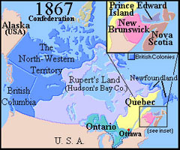

Slide 8
Reasons for Confederation
Political Deadlock:
By the 1850s, people were unhappy with the political system. Upper Canada and Lower Canada became a single colony: Province of Canada.
The English members in Canada West and the Canadien members in Canada East had just one Assembly between them.
The English made up a majority. The Canadiens were often outvoted on matters that were very important to them.

Slide 9
The Act of Union had given Canada East and West the same number of seats in the Assembly.
Each side fought over the amount of seats and the fight over rep by pop led to deadlocks in the Assembly. It was time for a change.
What are reasons for the English and the French to be for Rep by Pop?
What are reasons for the English and the French to not be for Rep by Pop?

Slide 10
Reasons for Confederation:
Britain Lets Go:
By 1846, the mercantile system was no longer working.
Britain’s new manufacturing industries were getting bigger. Britain needed to find more places to sell its goods.
It decided to reduce or remove taxes on goods imported from all countries.
Britain began free trade.
The colonies no longer had an assured market for their goods.
Britain wanted to let go of their colonies.

Slide 11
Reasons for Confederation:
Shifting Trade Partners:
In 1854, The BNA and US signed a trade agreement.
It created reciprocity between the colonies and the US
Fish, Timber, and grain could flow both ways across the border free of any import taxes.
After 10 years the Americans ended this agreement and the colonies had to face an economic crisis.
Ideas began to rise to trade with BNA colonies
Read pg 152
How has trade changed with BNA?

Slide 12
Reasons for Confederation:
Defending British North America:
In 1861, civil war broke out in the USA
The two main issues were slavery and power of the states to make their own laws.
Most colonists in BNA opposed slavery
Britain’s textile industry depended on the cotton from the south. It looked like Britain was supporting the south
As a result, USA were suspicious of Britain and BNA

Slide 13
When the war ended, some Americans wanted to punish Britain for supporting the South, others wanted to take over the colonies for other reasons.
They believed in Manifest Destiny
The colonist feared the US. In union, perhaps the colonies could protect themselves better.
Is the idea of Manifest Destiny a good reason to unite Canada
The colonist had to face another issue: the Fenians. Read pg 153 and Red booklet

Slide 14
Reasons for Confederation:
The Railway:
In the mid 19th century, a railway boom was taking place in BNA.
Before railways, geography had kept the colonies isolated.
Then it allowed farmers to get their crops to market.
Tracks connected towns and cities from east and west.
Businesses could move their goods quickly and easily.
People began to talk about building a railway linking Canada West with Halifax. It could only go ahead if the colonies were united (because of money issues)

Slide 15
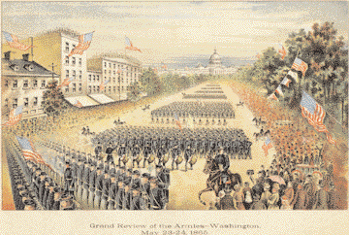
Figure 7.7- A grand review of the armies after the Civil War, Washington, DC, 1865.
When the war ended, the United States suddenly had a large and powerful army with nothing to do.
Q. Did the colonists have good reason to
worry about an American invasion? Why or why not?

Slide 16
Facts about maritime colonies
New Brunswick Economy: Forestry & fishing Most important city: Saint John Famous for its wooden sail ships Acadians in the north Largest group of colonists: the Irish | Prince Edward Island Economy: Fishing & Farming (Fertile Soil) Most important city: Charlottetown No bridges to the mainland The smallest colony in area & population
Nova Scotia Economy: Fishing Most important city: Halifax (Naval Center) Land good for farming Trade with colonies in Caribbean Largest group of colonies: the Scots About 1, 500 Mi’kmaq | Newfoundland Economy: Fishing (exported from Britain) & seal hunting. Most important city: St. John’s Land good for farming: None Isolated from other colonies Very close ties to Britain

Slide 17
The “Golden Age” of the Maritimes
1840-1870
Age of wind, wood, and sail.
Economies were growing and doing really well ☺
BNA had the 4th largest shipping fleet in the world. Britain, Norway, United States had bigger fleets.
70% of ships were built in Maritimes
(Ship Yard in Marystown)

Slide 18
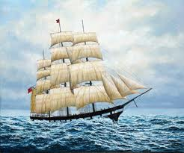
Marco Polo

Slide 19
Would A Union Help or Hinder?
People who supported the making of a country saw that the world was changing.
New technologies based on coal, iron, and steel threatened to end the age of wood, wind, and sail.
Union would give them access to the bigger Canadian provinces.
Proposed railway was very attractive.

Slide 20
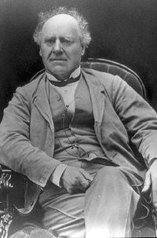
JOSEPH HOWE: (Leading Politician in NS during Confederation)

Slide 21
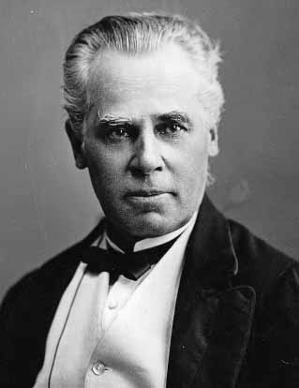
George Etienne Cartier
(Leader of the Quebec Politician
During Confederation)

Slide 22
#4 - Structure of
Canadian government
1867- BNA Act was passed
The Dominion of Canada was now a country!
Since 1935, the Governor, has been chosen by Prime Minister.
Parliament was divided into 2 parts:
Elected House of Commons
Appointed Senate

Slide 23
A Federal System
Created 2 levels government
Central Government
Provincial Government
* Check out Table on Next Slide!
BNA Act states that the Federal Government has the power to make laws for the “peace, order, and good government” of Canada.

Slide 24
Federal Powers | Provincial Powers | Shared Powers
Post Office | Education | Agriculture
Taxation | Highways | Immigration
Fisheries | Courts
Marriage & Divorce | Provincial & Local Police
Banking | Hospitals

Slide 25
A Limited Democracy
1867, Canada was a Democracy.
Voting
Women ownership
Only about 11% of population had ability to vote
Today, all Canadians over age of 18 can vote

Slide 26
THE DECISIONS THAT WENT INTO THE BNA ACT HAVE STRONGLY INFLUENCED WHAT CANADA HAS BECOME.
IT MADE EDUCATION FOR EXAMPLE, A PROVINCIAL RESPONSIBILITY.

Slide 27
IT’S PROJECT TIME!

Slide 28
POSTER PROJECT for Chapter 7
Create a poster on 8 x 14 white paper.
It is your job to make it look awesome!
Due Date: ☺☺☺
Must include:
Flag for Province
Name of Province at the top
Year they joined Confederation
2 Reasons for joining Confederation
2 Reasons against joining Confederation

Slide 29
CHECKLIST FOR INDIVIDUAL POSTER
___ Choose ONE Province
___ Main theme is Confederation
___ Hand in ON TIME
___ Include Name of Province
___ Include YEAR the province joined
___ Find picture of and draw provincial flag
___ 2 Headings must be NEAT & Tidy
(Reasons FOR Confed./Reasons AGAINST Confed.)
___ At least 2 reasons province had for joining
___ At least 2 reasons province had against joining
___ Creative (Color, Pictures, Font)
TOTAL: /10

Slide 30
During Presentations
Students are note taking and completing assigned chart.

Slide 31
Name of Province | Year Joined Confederation | Reasons FOR Joining Confederation | Reasons AGAINST joining Confederation
Ontario (West)
Quebec (East)
Newfoundland
Nova Scotia
Prince Edward Island
New Brunswick

